Slide 1
MRI Imaging of Soft Tissue Tumours of the Foot and Ankle
Peter Hughes, Rhian Miranda, Anthony J. Doyle
Insights into Imaging · 2019 · 10:60
doi:10.1186/s13244-019-0749-z
Notes:
Main Message
This review explains how MRI characterises foot and ankle soft tissue tumours and identifies lesions requiring biopsy.
Talking Points
Most lesions in this region are benign, but malignant processes can closely mimic them. The review focuses on MRI appearances that support differential diagnosis, local staging and referral decisions.
Transition
"We will first map the review’s diagnostic pathway, then examine characteristic benign and malignant lesions."
Suggested Time
30 seconds

Slide 2
MRI SOFT TISSUE TUMORS OF THE FOOT
02 / 28
From Initial Triage to Biopsy Planning
Imaging pathway: US, MRI and complementary radiography or CT
Characteristic MRI appearances of common benign lesions
Malignant lesions, mimics and features raising suspicion
Biopsy indications, planning principles and key takeaways
Notes:
Main Message
The presentation follows the review from imaging selection through lesion characterisation and biopsy planning.
Talking Points
The first section covers when MRI should follow ultrasound and how other modalities contribute. The central sections separate benign entities from malignant lesions before concluding with referral and biopsy criteria.
Transition
"The diagnostic pathway begins with recognising both the rarity of these masses and the consequences of missing malignancy."
Suggested Time
45 seconds

Slide 3
MRI SOFT TISSUE TUMORS OF THE FOOT
03 / 28
Rare Malignancies Can Closely Mimic Benign Masses
Foot and ankle soft tissue masses are relatively infrequent and may pose a diagnostic dilemma.
The vast majority of neoplastic and non-neoplastic lesions in this region are benign.
The most common malignancies are synovial sarcoma and pleomorphic undifferentiated sarcoma.
A lesion lacking features of a specific benign entity should be regarded as malignant until proven otherwise.
Notes:
Main Message
Although most lesions are benign, imaging must reliably identify the uncommon aggressive mass.
Talking Points
Frequency alone cannot establish benignity because malignant lesions may have deceptively indolent appearances. The review therefore emphasises knowledge of characteristic benign patterns and a low threshold for further assessment when those patterns are absent.
Transition
"That principle determines when ultrasound is sufficient and when MRI becomes necessary."
Suggested Time
1 minute

Slide 4
MRI SOFT TISSUE TUMORS OF THE FOOT
04 / 28
MRI Follows Ultrasound When Risk or Uncertainty Persists
US can establish cystic lesions and diagnose selected benign entities, including plantar fibromatosis.
US requires caution because interpretive difficulty may delay diagnosis of malignant lesions.
MRI is indicated when malignancy is plausible or a lesion is incompletely evaluated.
MRI is also indicated for lesions > 5 cm, deep to or crossing fascia, or at a previous resection site.
Notes:
Main Message
Ultrasound supports initial triage, but defined risk features and incomplete assessment require MRI.
Talking Points
Ultrasound may be diagnostic for ganglions, synovial cysts, stable superficial lipoma, Morton neuroma and several other benign conditions. MRI adds tissue characterisation, local staging and precise mapping to fascia, bone, muscle and neurovascular structures.
Transition
"MRI remains central, but complementary modalities answer questions that MRI may not resolve alone."
Suggested Time
1 minute

Slide 5
MRI SOFT TISSUE TUMORS OF THE FOOT
06 / 28
Complementary Imaging Clarifies Mineralisation, Flow and Extent
Radiography characterises mineralisation, demonstrates phleboliths and assesses bone or joint involvement.
CT is useful in the foot and ankle because of complex anatomy and overlapping structures.
FDG PET/CT is not usually indicated for the initial evaluation of a soft tissue lesion.
FDG PET/CT can assess distant metastases, treatment response and viable targets for biopsy.
Notes:
Main Message
Radiography, CT and FDG PET/CT complement MRI for selected structural and oncologic questions.
Talking Points
Plain films are particularly valuable when calcification or phleboliths are suspected. FDG PET/CT is reserved from routine initial assessment, although higher-grade sarcomas generally demonstrate higher SUV max and viable uptake can guide sampling.
Transition
"Advanced MRI sequences provide additional tissue information, but none eliminates diagnostic overlap."
Suggested Time
1 minute

Slide 6
MRI SOFT TISSUE TUMORS OF THE FOOT
07 / 28
Advanced MRI Adds Evidence but Not Standalone Certainty
PMRS may show an elevated choline peak associated with high cellular turnover in malignancy.
SWI improves detection of low-signal haemosiderin, melanin and calcification.
Malignant lesions generally have lower ADC values than benign lesions; myxoid tumours have higher ADC.
DCE evaluates enhancement and washout, identifies viable tumour and may detect residual or recurrent disease.
Signal, morphology and location can identify several benign entities.
Notes:
Main Message
Functional and susceptibility techniques refine characterisation and biopsy targeting but remain subject to overlap.
Talking Points
Abscess cores restrict diffusion more than necrotic tumour, while necrotic tumours tend to restrict more in solid components. Considerable benign–malignant overlap exists across these techniques, and radiomic analysis is not yet mature.
Transition
"With that imaging framework established, the next section reviews benign lesions with recognisable patterns."
Suggested Time
1 minute

Slide 7
MRI SOFT TISSUE TUMORS OF THE FOOT
08 / 28
Fibromatosis Is Defined by Fascial Origin and Collagen
Plantar fibromatosis is bilateral in up to 20–50% of cases; multiple nodules occur in 33% cases.
It forms a fusiform plantar-fascial mass, usually T1 hypointense and T2 iso- to hyperintense.
Early cellular lesions are more T2 hyperintense; mature fibrotic lesions become low signal on T2W.
Deep fibromatosis shows a fascial tail in up to 80% cases and low-signal collagen bands.
Notes:
Main Message
Fascial attachment and low-signal collagen are central clues to plantar and deep fibromatosis.
Talking Points
Plantar fibromatosis most often affects the distal two-thirds of the fascia and is more often medial than lateral. Deep fibromatosis is locally aggressive, may encase adjacent structures and recur after resection, but it does not metastasise.
Transition
"Vascular lesions are distinguished instead by flow characteristics, phleboliths and enhancement."
Suggested Time
1 minute

Slide 8
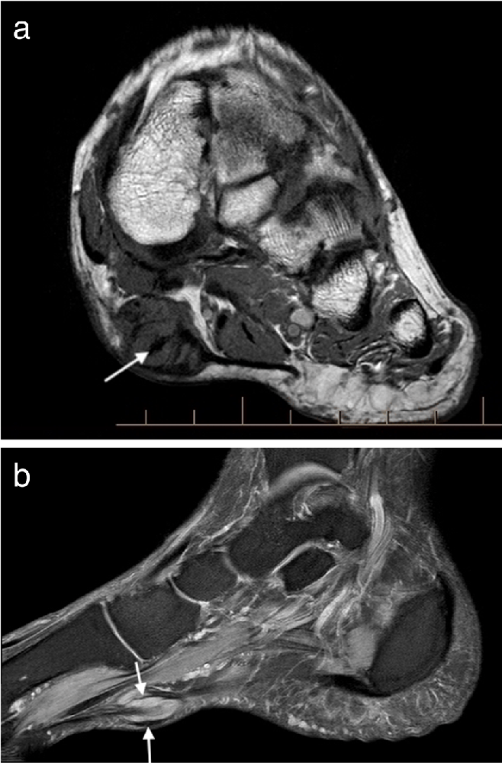
FIGURE
05 / 28
Plantar fibroma
Fig. 1 Plantar fibroma. a Sagittal T2 fat suppressed (T2FS) and ( b ) coronal T1-weighted image of the foot demonstrating a heterogeneous mass centred on the plantar fascia, distinct from…
From page 3
Notes:
Full caption (fig 1, source page 3): Fig. 1 Plantar fibroma. a Sagittal T2 fat suppressed (T2FS) and ( b ) coronal T1-weighted image of the foot demonstrating a heterogeneous mass centred on the plantar fascia, distinct from the

Slide 9
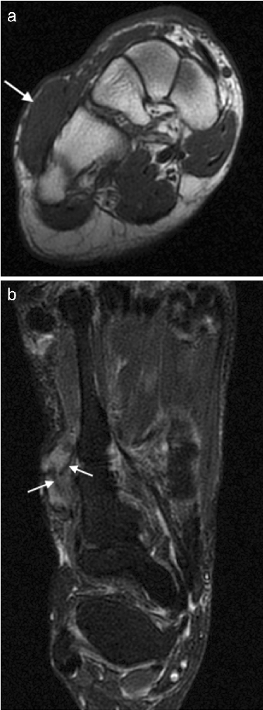
FIGURE
09 / 28
Deep fibromatosis
Fig. 2 Deep fibromatosis. Axial T1W ( a ) and T2FS ( b ) images showing a mass on the dorsum of the foot. The mass is isointense to muscle on T1W. On T2FS, the mass is hyperintense with…
From page 4
Notes:
Full caption (fig 2, source page 4): Fig. 2 Deep fibromatosis. Axial T1W ( a ) and T2FS ( b ) images showing a mass on the dorsum of the foot. The mass is isointense to muscle on T1W. On T2FS, the mass is hyperintense with linear

Slide 10
MRI SOFT TISSUE TUMORS OF THE FOOT
10 / 28
Flow Characteristics Separate Vascular Malformation Subtypes
Vascular malformations account for 7% of benign foot and ankle soft tissue lesions.
Most are slow-flow, T2-hyperintense lesions that may demonstrate fluid-fluid levels.
High-flow arteriovenous malformations show serpiginous flow voids and generally avid enhancement.
Phleboliths are low signal on all sequences and should be correlated with radiographs.
Notes:
Main Message
MRI flow patterns and radiographic phleboliths help classify vascular malformations.
Talking Points
These lesions usually present before age 30 and may cause exercise-related pain through vascular steal. Angiomyoma is a separate small, painful vascular smooth-muscle tumour, usually < 2 cm, with marked enhancement.
Transition
"Fat-containing and cartilage-forming masses have different signal signatures and different warning signs."
Suggested Time
1 minute

Slide 11
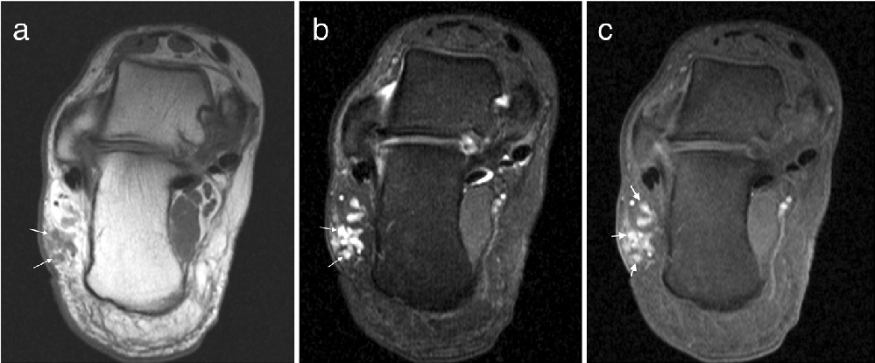
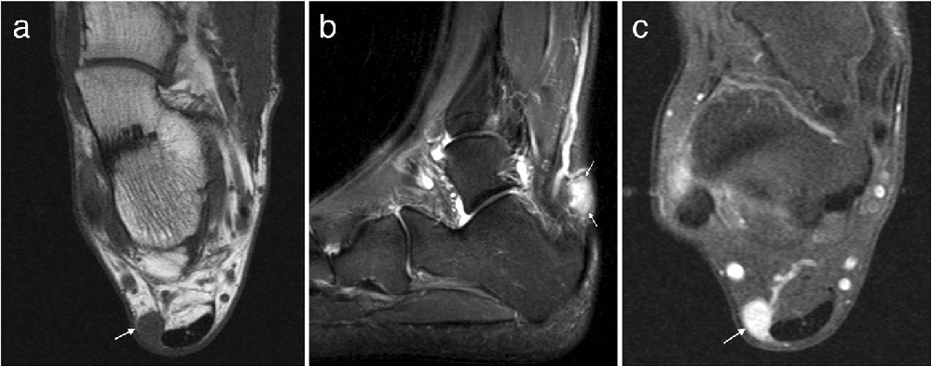
FIGURE
11 / 28
Vascular malformation and Angiomyoma
Fig. 3 Vascular malformation. a Axial T1W and ( b ) proton density with fat suppression (PDFS) images of the ankle demonstrating a low flow vascular malformation overlying the lateral…
Fig. 4 Angiomyoma. Axial T1W ( a ), sagittal T2FS ( b ) and post contrast T1FS ( c ) images of the ankle showing a well-defined lesion adjacent to the Achilles tendon which appears…
From page 5
From page 5
Notes:
Full caption (fig 3, source page 5): Fig. 3 Vascular malformation. a Axial T1W and ( b ) proton density with fat suppression (PDFS) images of the ankle demonstrating a low flow vascular malformation overlying the lateral aspect of the ca
Full caption (fig 4, source page 5): Fig. 4 Angiomyoma. Axial T1W ( a ), sagittal T2FS ( b ) and post contrast T1FS ( c ) images of the ankle showing a well-defined lesion adjacent to the Achilles tendon which appears isointense on T1W,

Slide 12
MRI SOFT TISSUE TUMORS OF THE FOOT
12 / 28
Lipoma and Soft Tissue Chondroma Have Recognisable Matrices
Lipoma follows subcutaneous fat on T1W and T2W and loses signal uniformly with fat suppression.
Septa > 2 mm, enhancing nodules, rapid painful growth or < 75% fat raise concern for malignancy.
Soft tissue chondroma is a well-demarcated lobulated mass, low–intermediate on T1W and high on T2W.
Central signal voids in chondroma reflect mineralisation that may be clearer on radiography.
Notes:
Main Message
Uniform fat suppression supports lipoma, while cartilage signal and mineralisation support soft tissue chondroma.
Talking Points
Intramuscular fibres traversing a lipoma can mimic thick septa and should not automatically be labelled malignant. Large soft tissue chondromas may be difficult to distinguish from the rare extraosseous chondrosarcoma.
Transition
"Haemosiderin and mineralised bodies provide the key clues in synovial proliferative disorders."
Suggested Time
1 minute

Slide 13
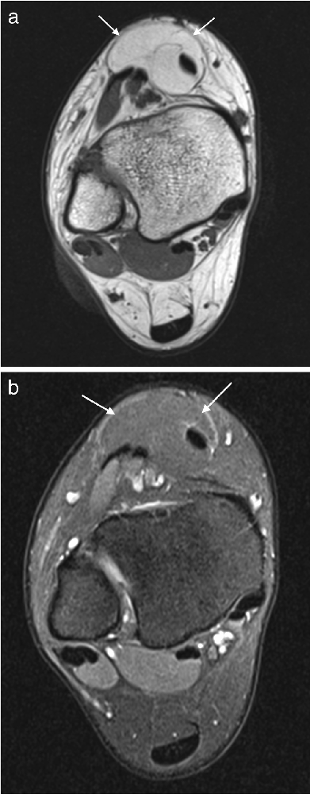
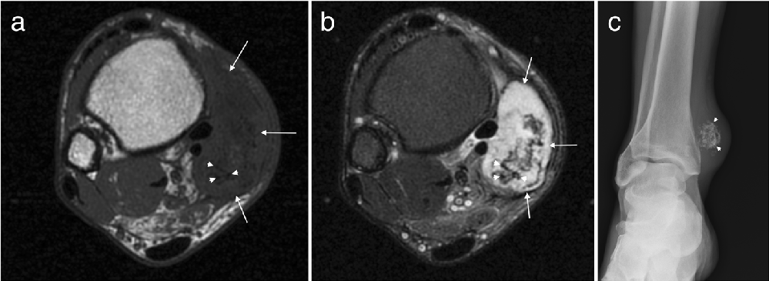
FIGURE
13 / 28
Lipoma and Soft tissue chondroma
Fig. 5 Lipoma. Axial T1W ( a ) and PDFS ( b ) images of the ankle demonstrating an encapsulated lesion (arrows). The lesion is isointense to fat on T1 with uniform loss of signal on PDFS
Fig. 6 Soft tissue chondroma. Axial T1W ( a ) and T2FS ( b ) images of the ankle with a large well-defined posteromedial mass (arrows) which appears T1 hypointense and T2 hyperintense with…
From page 6
From page 7
Notes:
Full caption (fig 5, source page 6): Fig. 5 Lipoma. Axial T1W ( a ) and PDFS ( b ) images of the ankle demonstrating an encapsulated lesion (arrows). The lesion is isointense to fat on T1 with uniform loss of signal on PDFS
Full caption (fig 6, source page 7): Fig. 6 Soft tissue chondroma. Axial T1W ( a ) and T2FS ( b ) images of the ankle with a large well-defined posteromedial mass (arrows) which appears T1 hypointense and T2 hyperintense with internal lo

Slide 14
MRI SOFT TISSUE TUMORS OF THE FOOT
14 / 28
Blooming and Mineralised Bodies Distinguish Synovial Disorders
PVNS is intra-articular; giant cell tumour of tendon sheath is the extra-articular manifestation.
Haemosiderin produces characteristic gradient-echo blooming, but this finding is not specific.
GCT is tendon-related and often more homogeneously hypointense and enhancing than PVNS.
Synovial osteochondromatosis evolves from T2-bright nodules to mineralised or ossified bodies.
Notes:
Main Message
PVNS, GCT and synovial osteochondromatosis are recognised through location, haemosiderin or evolving mineralisation.
Talking Points
Blooming also occurs with haemophilia, amyloid and rheumatoid arthritis. Tendon sheath fibroma is an important GCT mimic but does not demonstrate blooming, while radiographs or CT better classify mineralised bodies in synovial osteochondromatosis.
Transition
"Peripheral nerve sheath tumours add a set of classic nerve-related signs, though these are not fully specific."
Suggested Time
1 minute

Slide 15
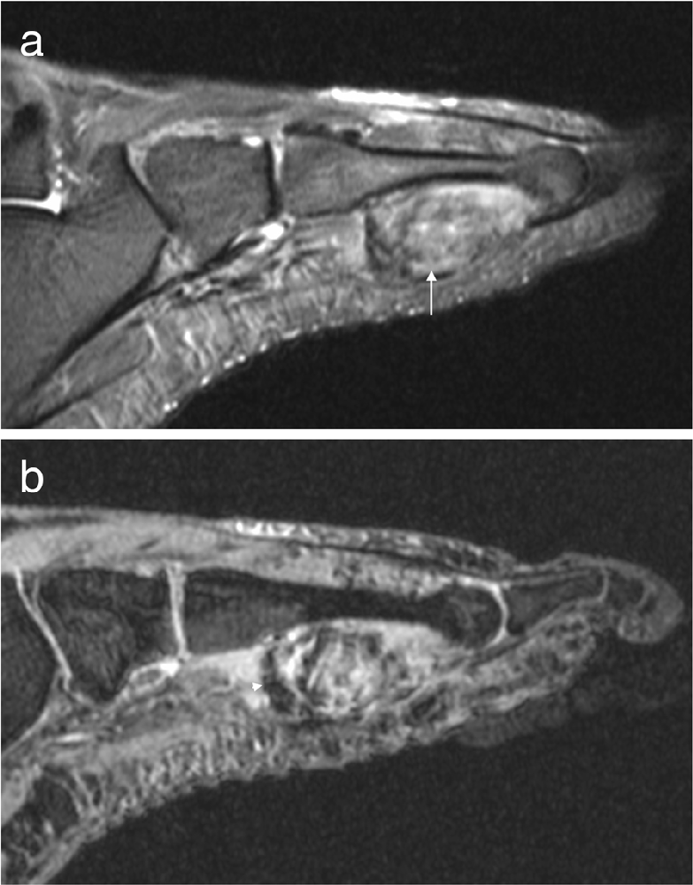
FIGURE
15 / 28
PVNS
Fig. 7 PVNS. Coronal T1 ( a ) and axial T2FS ( b ) images of the ankle demonstrating extensive abnormal soft tissue with intermediate signal on T1W and hypointense on T2FS
From page 8
Notes:
Full caption (fig 7, source page 8): Fig. 7 PVNS. Coronal T1 ( a ) and axial T2FS ( b ) images of the ankle demonstrating extensive abnormal soft tissue with intermediate signal on T1W and hypointense on T2FS

Slide 16
MRI SOFT TISSUE TUMORS OF THE FOOT
16 / 28
Nerve-Related Signs Suggest Peripheral Nerve Sheath Tumours
Neurofibroma and schwannoma account for 5.4% and 3.9% of benign lesions in this region.
Both are generally ovoid, T1 isointense and T2 hyperintense with heterogeneous enhancement.
Classic signs include split fat, ball on a string and the T2 target sign.
Schwannomas are eccentric and separable; neurofibromas infiltrate the nerve and may require sacrifice.
Malignant masses may appear indolent, cystic or inflammatory.
Notes:
Main Message
Anatomic continuity with a nerve and classic MRI signs support a peripheral nerve sheath origin.
Talking Points
Most lesions are isolated, although multiple or plexiform neurofibromas may occur in neurofibromatosis type I. The target sign is not specific and may also occur in schwannoma or malignant peripheral nerve sheath tumour.
Transition
"The malignant section begins with synovial sarcoma, the region’s most common malignancy and a major benign mimic."
Suggested Time
1 minute

Slide 17
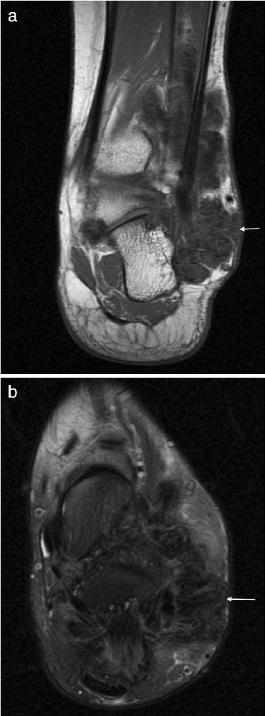
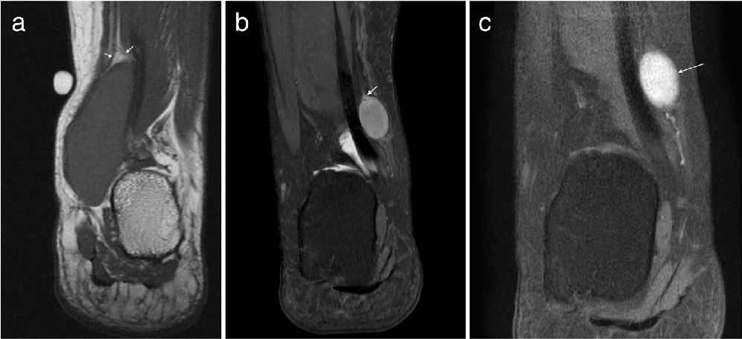
FIGURE
17 / 28
Giant cell tumour of the tendon sheath and Schwannoma
Fig. 8 Giant cell tumour of the tendon sheath. a Sagittal T2FS image shows a heterogeneously hyperintense lesion underlying the metatarsal, related to the flexor tendon. b Gradient echo…
Fig. 10 Schwannoma. a Coronal T1W image demonstrating a well-defined homogeneously T1 isointense lesion with the split fat sign (arrows). b Coronal T2FS image of another schwannoma showing…
From page 8
From page 9
Notes:
Full caption (fig 8, source page 8): Fig. 8 Giant cell tumour of the tendon sheath. a Sagittal T2FS image shows a heterogeneously hyperintense lesion underlying the metatarsal, related to the flexor tendon. b Gradient echo imaging
Full caption (fig 10, source page 9): Fig. 10 Schwannoma. a Coronal T1W image demonstrating a well-defined homogeneously T1 isointense lesion with the split fat sign (arrows). b Coronal T2FS image of another schwannoma showing a homogeneo

Slide 18
MRI SOFT TISSUE TUMORS OF THE FOOT
18 / 28
Synovial Sarcoma Can Look Cystic Despite Guarded Outcomes
Synovial sarcoma is the region’s most common malignancy; 18–25% occur in the ankle and foot.
It typically affects ages 15–45, and 75% occur within 5 cm of a joint.
Recurrence follows resection in approximately 50% cases; metastases occur in approximately 40%.
Small tumours may resemble simple cysts; atypical cystic lesions require post-contrast imaging.
Notes:
Main Message
Synovial sarcoma’s cyst-like appearance can conceal a malignancy with substantial recurrence and metastatic risk.
Talking Points
Symptoms typically persist for 2–4 years, and pain or tenderness is common. Larger lesions may show the triple sign, bowl-of-grapes septation, fluid-fluid levels in 10–25% cases and calcification in 20–30%.
Transition
"Other sarcomas are less common but contribute age-specific, vascular and nerve-related warning patterns."
Suggested Time
1 minute 15 seconds

Slide 19
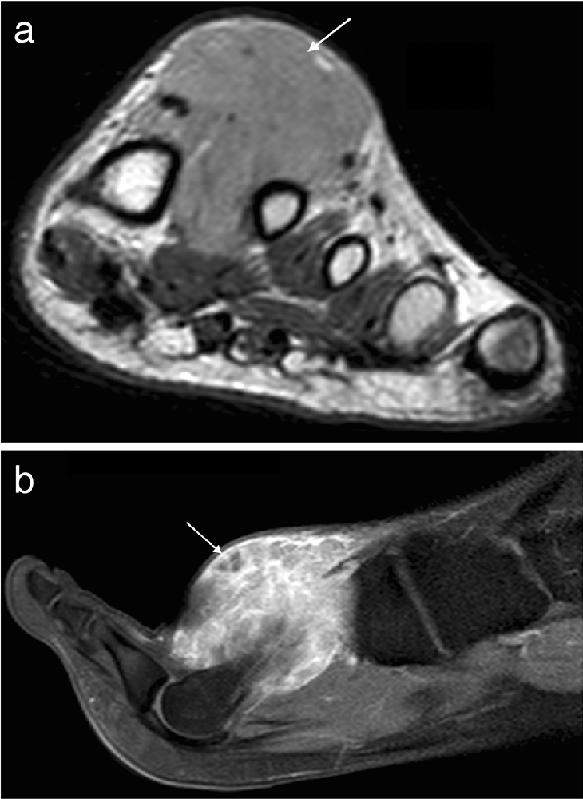
FIGURE
19 / 28
Synovial sarcoma
Fig. 11 Synovial sarcoma. Short axis T2FS image of the foot ( a ) showing a heterogeneous T2 hyperintense mass on the plantar aspect of the foot with heterogeneous enhancement of the viable
From page 10
Notes:
Full caption (fig 11, source page 10): Fig. 11 Synovial sarcoma. Short axis T2FS image of the foot ( a ) showing a heterogeneous T2 hyperintense mass on the plantar aspect of the foot with heterogeneous enhancement of the viable

Slide 20
MRI SOFT TISSUE TUMORS OF THE FOOT
20 / 28
Other Sarcomas Show Aggressive but Overlapping Features
Rhabdomyosarcoma is T1 iso- to hyperintense, heterogeneously T2 hyperintense and markedly enhancing.
Rhabdomyosarcoma 5-year survival is estimated at 27% in adults and 61% in children.
Malignant nerve sheath tumours are often > 5 cm, poorly defined and associated with oedema.
Lobulation, rapid growth and adjacent bone destruction increase suspicion for nerve sheath malignancy.
Notes:
Main Message
Rhabdomyosarcoma and malignant peripheral nerve sheath tumour have concerning patterns but no single definitive MRI feature.
Talking Points
Rhabdomyosarcoma may metastasise to lymph nodes, lungs and bones and often contains prominent flow voids or haemorrhage. Malignant peripheral nerve sheath tumours are strongly associated with neurofibromatosis type 1 and may be impossible to separate from benign lesions on imaging alone.
Transition
"Several additional malignancies have useful clues, but their appearances remain largely nonspecific."
Suggested Time
1 minute

Slide 21
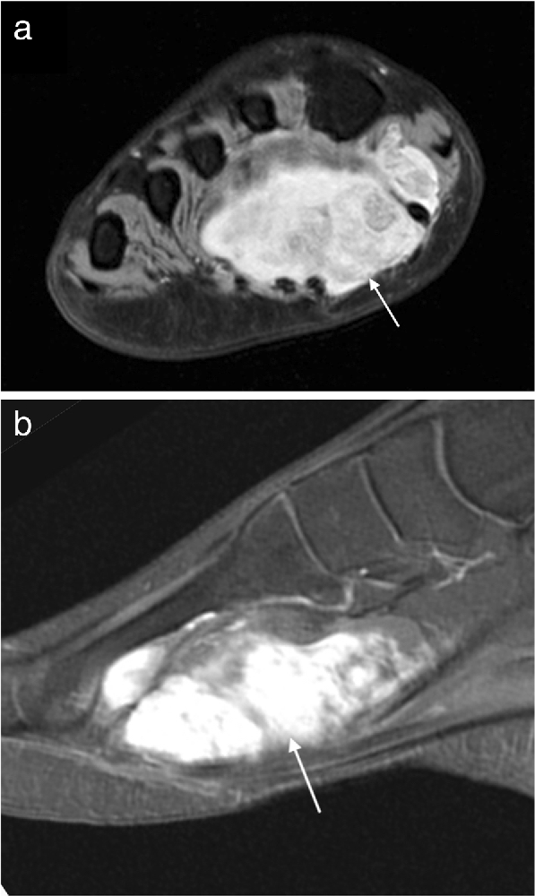
FIGURE
21 / 28
Rhabdomyosarcoma
Fig. 12 Rhabdomyosarcoma. Short axis T1 image ( a ) of the foot of a 14-year-old girl demonstrating a hyperintense mass in the first web- space with avid enhancement on postcontrast T1FS…
From page 10
Notes:
Full caption (fig 12, source page 10): Fig. 12 Rhabdomyosarcoma. Short axis T1 image ( a ) of the foot of a 14-year-old girl demonstrating a hyperintense mass in the first web- space with avid enhancement on postcontrast T1FS imaging ( b )

Slide 22
MRI SOFT TISSUE TUMORS OF THE FOOT
22 / 28
Skin, Lymphoid and Other Sarcomatous Lesions Require Context
Kaposi sarcoma may be exophytic and pedunculated, T1 low, T2 high and avidly enhancing.
Lymphoma is usually T1 isointense, T2 intermediate–high and mildly enhancing without necrosis or haemorrhage.
Pigmented melanoma is characteristically T1 hyperintense, T2 hyperintense and avidly enhancing.
An enhancing mass beside chronic ulceration or osteomyelitis should raise concern for squamous carcinoma.
Notes:
Main Message
Clinical setting and lesion composition are essential when MRI findings are not specific.
Talking Points
Clear cell sarcoma may be T1 hyperintense in up to 52% cases because of melanocytic content. Myxoid liposarcoma and myxofibrosarcoma show T2-bright myxoid matrix with mild-to-moderate or rim-and-septal enhancement.
Transition
"Across these entities, a consistent group of features should trigger escalation to tissue diagnosis."
Suggested Time
1 minute

Slide 23
MRI SOFT TISSUE TUMORS OF THE FOOT
23 / 28
Size, Depth and Invasion Raise Suspicion for Malignancy
Features favouring malignancy include size > 5 cm, deep location and irregular margins.
Inhomogeneous signal, haemorrhage, necrosis and early inhomogeneous enhancement are adverse features.
Surrounding oedema and invasion of bone or neurovascular structures further increase concern.
Considerable overlap means these features support suspicion rather than establish diagnosis.
Notes:
Main Message
Malignancy is more likely when multiple adverse morphologic and enhancement features coexist.
Talking Points
No individual feature is sufficiently specific to replace histology in an indeterminate lesion. The practical implication is to avoid reassuring labels when a mass lacks the complete pattern of a recognised benign entity.
Transition
"When suspicion remains, biopsy indication and technique become part of the diagnostic pathway."
Suggested Time
1 minute

Slide 24
MRI SOFT TISSUE TUMORS OF THE FOOT
24 / 28
Core Biopsy Requires Sarcoma-Centre Planning
Biopsy is indicated for suspected malignancy, any superficial lesion > 5 cm and any deep lesion.
Indeterminate lesions should also undergo biopsy at a regional sarcoma referral centre.
Core biopsy is required; fine needle aspiration is inadequate.
The tract should avoid unaffected compartments and be removed en bloc during surgery.
Notes:
Main Message
Biopsy is not merely a sampling step; its indication, route and setting affect definitive treatment.
Talking Points
Planning should involve multidisciplinary input, including an oncologic surgeon. MRI, US or FDG PET can target viable enhancing tumour while avoiding necrosis or haemorrhage and reducing nondiagnostic sampling.
Transition
"The review’s central lessons combine confident recognition of benign patterns with disciplined escalation of everything else."
Suggested Time
1 minute

Slide 25
MRI SOFT TISSUE TUMORS OF THE FOOT
25 / 28
Summary — Additional Evidence, Limitations & Next Steps
This 2019 pictorial review synthesises MRI characteristics rather than reporting a new patient cohort.
Synovial sarcoma may show fluid-fluid levels in 10–25% and calcification in 20–30% cases.
Small synovial sarcomas can resemble cysts; aspiration may disrupt the capsule and compromise resection.
Target viable tumour with MRI, US or FDG PET and avoid necrotic or haemorrhagic areas.
Advanced MRI findings overlap substantially; higher ADC in desmoid fibromatosis needs larger validation studies.
Radiomics has prognostic potential in soft tissue sarcoma but is not yet a mature technique.

Slide 26
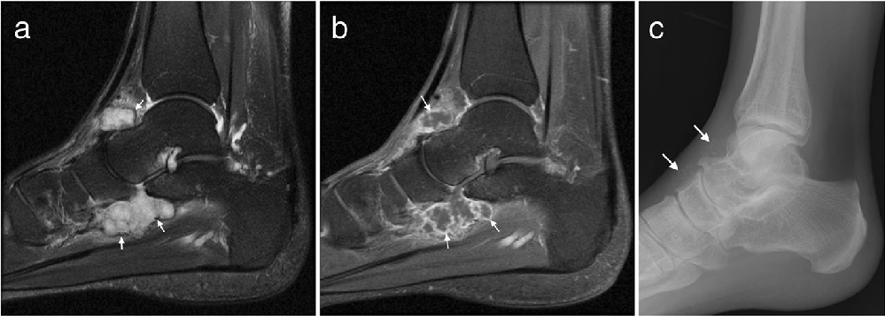
MRI SOFT TISSUE TUMORS OF THE FOOT
26 / 28
Key Takeaways
MRI is the modality of choice for characterisation, local staging and anatomic mapping.
Characteristic benign entities include plantar fibromatosis, lipoma, PVNS/GCT and synovial chondromatosis.
A mass without features of a specific benign entity should be treated as malignant until proven otherwise.
Suspicious, deep or indeterminate lesions require planned core biopsy at a regional sarcoma centre.
Fig. 9 Synovial chondromatosis. a Sagittal T2FS image of the ankle demonstrating a lobulated T2 hyperintense lesion with a low signal rim (arrows) and b avid synovial enhancement on post…
Notes:
Main Message
Reinforce the three to four ideas the audience should leave with.
Talking Points
Restate each takeaway in your own words; do not introduce new information here.
Transition
"That brings us to the end — I'm happy to take your questions."
Suggested Time
1 minute
Full caption (fig 9, source page 9): Fig. 9 Synovial chondromatosis. a Sagittal T2FS image of the ankle demonstrating a lobulated T2 hyperintense lesion with a low signal rim (arrows) and b avid synovial enhancement on post contrast T1FS

Slide 27
Selected References

Slide 28
Thank you.

