Slide 1
The State of U.S. Small Business in 2025
Decide where capital, capacity, and measurement can turn broad participation into durable growth

Slide 2
THE STATE OF US SMALL BUSINESS IN
02 / 17
The evidence follows scale, dynamism, inclusion, and policy
Move from enterprise structure to outcomes, opportunity gaps, and targeted interventions
1
2
3
4
Scale and structure
Dynamism and outcomes
Opportunity gaps
Policy action
Business population, employment, and employer status
Openings, closures, jobs, industries, and payroll
Geography, capital, ownership, rural reach, and exports
Target capital, capacity, markets, and measurement
Notes:
Main Message
The briefing follows a decision chain from business structure through economic outcomes and access gaps to policy action.
Talking Points
Scale establishes who participates, while dynamism shows which firms create or lose jobs. Geography, ownership, capital, and exports then identify where targeted intervention may have the greatest value.
Transition
"The headline numbers show both the breadth of participation and the need for careful interpretation."
Suggested Time
45 seconds

Slide 3
THE STATE OF US SMALL BUSINESS IN
03 / 17
Key numbers
Nonemployers dominate establishment count, while reported capital figures require definition checks
78.4%
Nearly $1.8T
$4.1B
U.S. establishments that were nonemployers, 2023 [1]
Revenue generated by nonemployer establishments, 2023 [1]
Equity raised through CalOSBA’s network, reported 2018–2025
$3.6B
Additional equity-raised figure displayed by CalOSBA, 2018–2
Notes:
Main Message
Nonemployers represent the broadest enterprise base, but the two displayed CalOSBA equity figures must be reconciled before informing decisions.
Talking Points
The Census figures establish the scale and revenue contribution of nonemployers in 2023. CalOSBA displays two equity-raised figures for 2018–2025, so leaders should confirm definitions and overlap rather than aggregate them.
Transition
"The first structural distinction is whether an establishment has paid employees."
Suggested Time
1 minute

Slide 4
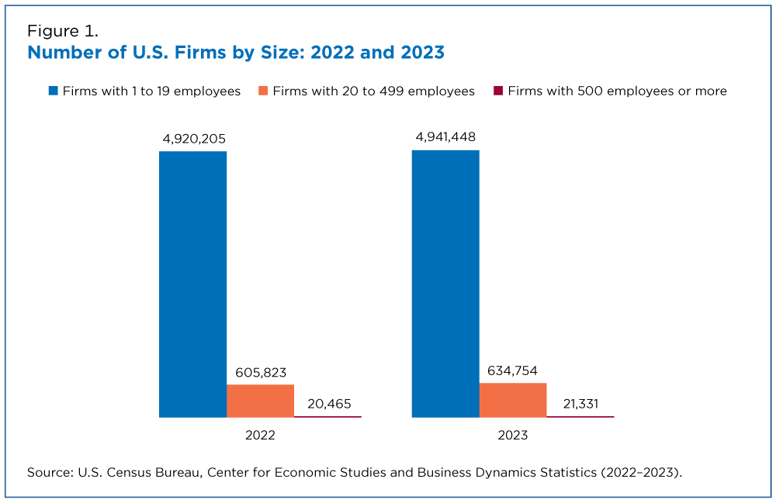
RESEARCH FIGURE
04 / 17
Number of U.S
Figure 1. Number of U.S. Firms by Size: 2022 and 2023
Sourced from recent web research
Notes:
Full caption (fig 1, source page 1): Figure 1. Number of U.S. Firms by Size: 2022 and 2023

Slide 5
THE STATE OF US SMALL BUSINESS IN
05 / 17
Nonemployers form the broad base of U.S. enterprise
Treat employer transition as a distinct scaling pathway, not an assumed outcome
78.4%
Nearly $1.8T
Share of U.S. establishments that were nonemployers, 2023 [1
Nonemployer establishment revenue, 2023 [1]
Notes:
Main Message
Programs should recognize nonemployers as a major economic base and separately support firms ready to hire.
Talking Points
Nonemployers have no paid employees and comprised 78.4% of establishments in 2023. Their nearly $1.8 trillion in revenue demonstrates economic significance, but employment and payroll analysis requires a separate employer-firm lens.
Transition
"That structural divide becomes more actionable when mapped to state exposure."
Suggested Time
1 minute

Slide 6
THE STATE OF US SMALL BUSINESS IN
06 / 17
Geographic dependence should shape state policy
Decision: build the map only after obtaining a cited state-level dataset
Evidence required
Policy levers [2]
Cited state-level employee-share dataset
Consistent definition: firms with fewer than 500 employees
Reference year displayed
Capital
Markets
Networks
Mobility
Notes:
Main Message
State policy should be calibrated to small-business employment dependence, but no state ranking should be published without cited data.
Talking Points
A consistent map can reveal where employees are most exposed to small-firm conditions. Pairing that exposure with capital, market, network, and mobility levers turns geography into an intervention framework.
Transition
"Beyond structural exposure, leaders need verified measures of business churn."
Suggested Time
1 minute

Slide 7
THE STATE OF US SMALL BUSINESS IN
07 / 17
Openings and closures reveal business churn
Decision: verify flow data before judging momentum
Openings
Closures
All establishments
Firms with fewer than 500 employees
March 2023–March 2024
All establishments
Firms with fewer than 500 employees
Identify temporary closures and reopenings
Notes:
Main Message
Leaders should assess churn using matched opening and closure measures rather than a single gross flow.
Talking Points
The comparison must separate economy-wide establishments from firms below 500 employees. Temporary closures and reopenings can distort interpretation, so definitions and verified values are prerequisites.
Transition
"Churn matters because job gains must exceed job losses to produce net growth."
Suggested Time
1 minute

Slide 8
THE STATE OF US SMALL BUSINESS IN
08 / 17
Net job growth depends on gains exceeding losses
Decision: publish the net only after reconciling every gain and loss component
1
2
3
4
5
Openings
Expansions
Closures
Contractions
Net result
Jobs added
Jobs added
Jobs lost
Jobs lost
Gains minus losses
Notes:
Main Message
Net job growth is credible only when openings and expansions are transparently reconciled with closures and contractions.
Talking Points
The gain-versus-loss logic should be shown for March 2023–March 2024. Small-business contribution must remain distinct from the economy-wide result, with verified values inserted only after reconciliation.
Transition
"Aggregate job flows can also obscure major differences across industries."
Suggested Time
1 minute

Slide 9
THE STATE OF US SMALL BUSINESS IN
09 / 17
Industry counts do not equal employment intensity
Decision: compare prevalence and employment share on separate scales
Firm prevalence
Employment intensity
Number of firms with fewer than 500 employees
Rank industries
Count scale
Small-business share of industry employment
Compare across industries
Percentage scale
Notes:
Main Message
Industry policy should not use firm counts as a proxy for small-business employment importance.
Talking Points
A sector can contain many small firms without those firms accounting for a comparable share of employment. Separate scales and explicit reference years prevent misleading comparisons.
Transition
"The same discipline is needed when comparing employment scale with payroll impact."
Suggested Time
1 minute

Slide 10
THE STATE OF US SMALL BUSINESS IN
10 / 17
Employment scale and payroll share measure different impacts
Decision: keep headcount, payroll, and long-run change as separate measures
Employment level
Payroll share
Long-run change
Number of workers
Point-in-time scale
Share of private-sector payroll
Compensation impact
Employment trend over time
Directional impact
Notes:
Main Message
Leaders should evaluate employment, payroll, and long-run change independently because each answers a different policy question.
Talking Points
Headcount measures scale, payroll share reflects compensation impact, and long-run change captures direction. Any 2022 values should be validated against the cited federal datasets before publication.
Transition
"Measurement precision is equally critical when assessing access to capital."
Suggested Time
1 minute

Slide 11
THE STATE OF US SMALL BUSINESS IN
11 / 17
Capital metrics require precise borrower definitions
Decision: standardize lending definitions before setting targets or comparing performance
≤$1M revenue
≤$1M loan
≤$100K loan
Loans to firms defined by borrower revenue
Loans defined by loan size
Small-dollar loan-size measure, not borrower size
Notes:
Main Message
Capital targets and performance comparisons must distinguish borrower size from loan size.
Talking Points
A loan to a firm with revenue of $1 million or less is not the same metric as a loan sized at $1 million or less. SBA guarantees serve firms unable to obtain reasonable credit elsewhere, and 2023 amounts should be added only after verification.
Transition
"Clear definitions are also essential when measuring ownership and employer gaps."
Suggested Time
1 minute

Slide 12
THE STATE OF US SMALL BUSINESS IN
12 / 17
Ownership gaps are clearest at the employer threshold
Decision: target the transition from ownership to sustained employment creation
Participation
Employer threshold
Share of business ownership
Total firms
Black-, Hispanic-, White-owned, and rural businesses
Share of workers
Incidence of firms with employees
Employer firms shown separately
Notes:
Main Message
Inclusive-growth policy should focus not only on ownership rates but also on which businesses cross the employer threshold.
Talking Points
Ownership share and worker share reveal different dimensions of participation. Employer incidence should be reported separately by demographic group and for rural businesses, using only verified 2022 data.
Transition
"For firms seeking growth beyond domestic markets, export capacity presents another threshold."
Suggested Time
1 minute

Slide 13
THE STATE OF US SMALL BUSINESS IN
13 / 17
Small exporters broaden reach but need capacity
Decision: pair verified export measures with readiness support
Exporter participation
Export value
Share of identified exporting firms
Exporter-count measure
Reference year: 2023
Share of goods-export value
Dollar-value measure
Reference year: 2023
Notes:
Main Message
Export policy should distinguish how many small firms export from how much value they export, then address the capabilities behind both.
Talking Points
Counts measure participation while export dollars measure economic value. Financing, market access, networks, and resilience should form the readiness package, but no figures should appear without a cited Census exporter source.
Transition
"Taken together, the evidence points to four immediate policy priorities."
Suggested Time
1 minute

Slide 14
THE STATE OF US SMALL BUSINESS IN
14 / 17
Policy should turn broad participation into durable growth
Executive ask: assign owners and measures to four priorities
1
2
3
4
Fix financing definitions
Build employer readiness
Expand durable growth
Track segmented outcomes
Separate borrower-size and loan-size measures
Help viable nonemployers develop hiring and operating capacity
Support succession, resilience, exports, and inclusion
Report employer status, geography, ownership, industry, and year
Notes:
Main Message
Leaders should approve a four-part framework that improves financing precision, employer readiness, durable growth, and segmented measurement.
Talking Points
The actions translate the evidence into a manageable operating agenda. Each priority needs a named owner, verified baseline, reference year, and outcome measure before implementation.
Transition
"The following references document the evidence used in this briefing."
Suggested Time
1 minute

Slide 15
Sources
Close: approve the action framework subject to source verification and definition checks

Slide 16
THE STATE OF US SMALL BUSINESS IN
16 / 17
References
Source dates are shown to preserve the distinction between 2025 framing and publication timing
Ref. | Publisher | Source | Publication / coverage
[1] | U.S. Census Bureau | “Census Bureau Data Tell the Small Business Story” | May 4, 2026
[2] | California Office of the Small Business Advocate | Website figures | 2018–2025
[3] | Congressional Research Service | “SBA: A Primer on Programs and Funding” | Mar. 13, 2026
Notes:
Main Message
The briefing relies on three primary references, with publication timing kept separate from each statistic’s measurement year.
Talking Points
The Census and CRS items are dated 2026, while the policy frame is 2025 and individual statistics carry their own source years. CalOSBA figures cover 2018–2025 and require definition checks before comparison.
Transition
"The final slide provides the complete supplied source list for follow-up and verification."
Suggested Time
45 seconds

Slide 17
Thank you.

